Slide 1
Effect of Hand-movement on the Presence of another Person in a Virtual Environment
Felix Bühler, Jan Leusmann, Jamie Ullerich
Virtual and Augmented Reality | Stuttgart | 12.07.2019

Slide 2

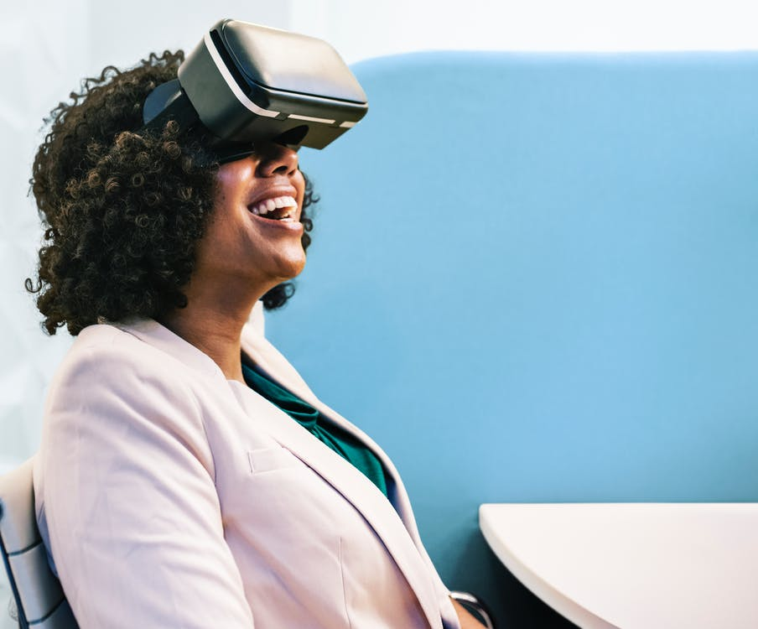
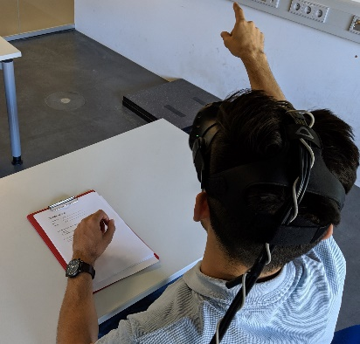
Motivation
Current Meetings
Virtual Reality
VR-Meetings: Does Hand-movement have a positive influence on Co-Presence?
Notes:
Felix

Slide 3
Study

Slide 4
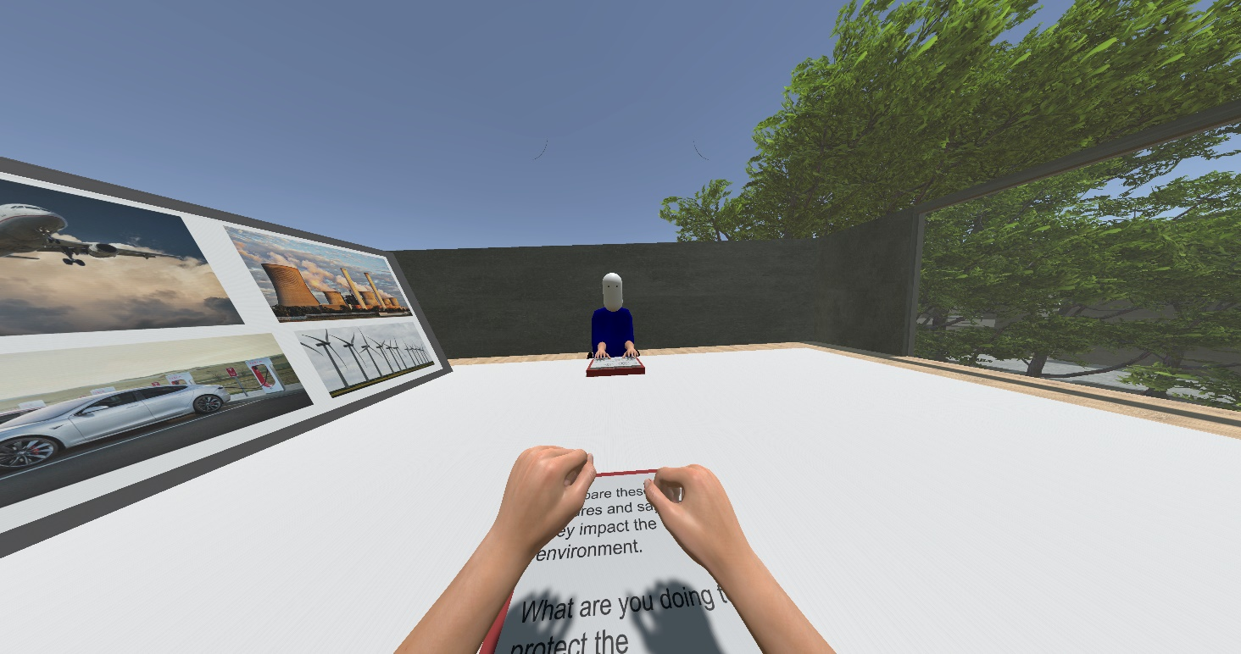
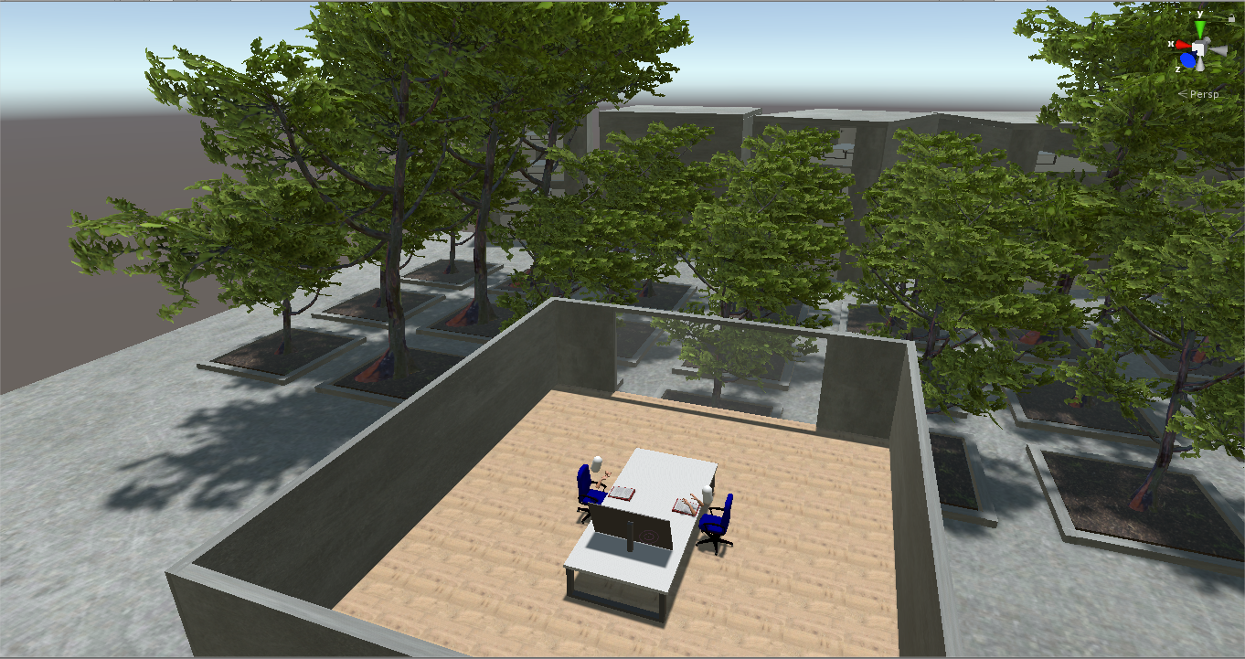
Setup
Notes:
Jan

Slide 5
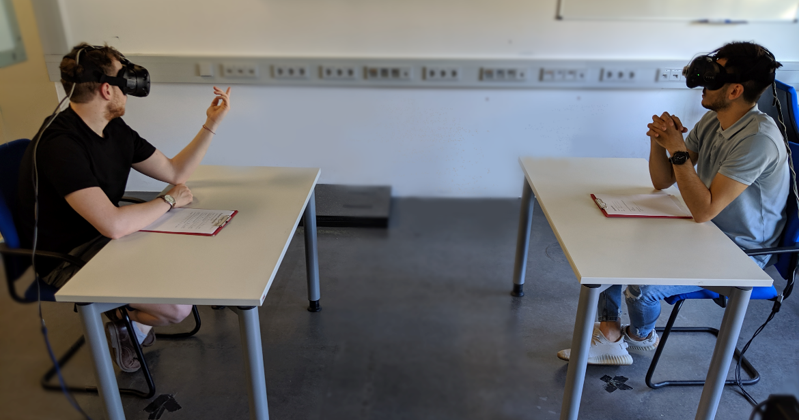
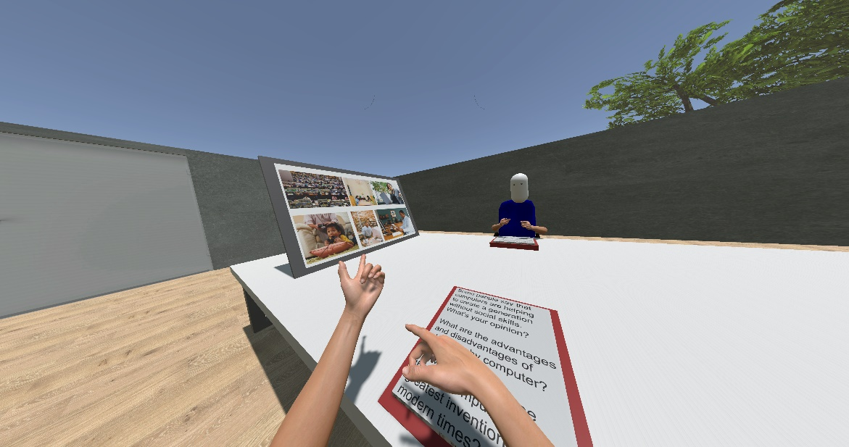
Setup
Notes:
12 participants
11 male, 1 female
23 – 28 years old (M = 24.5)
11: previous VR experience, 1 none

Slide 6
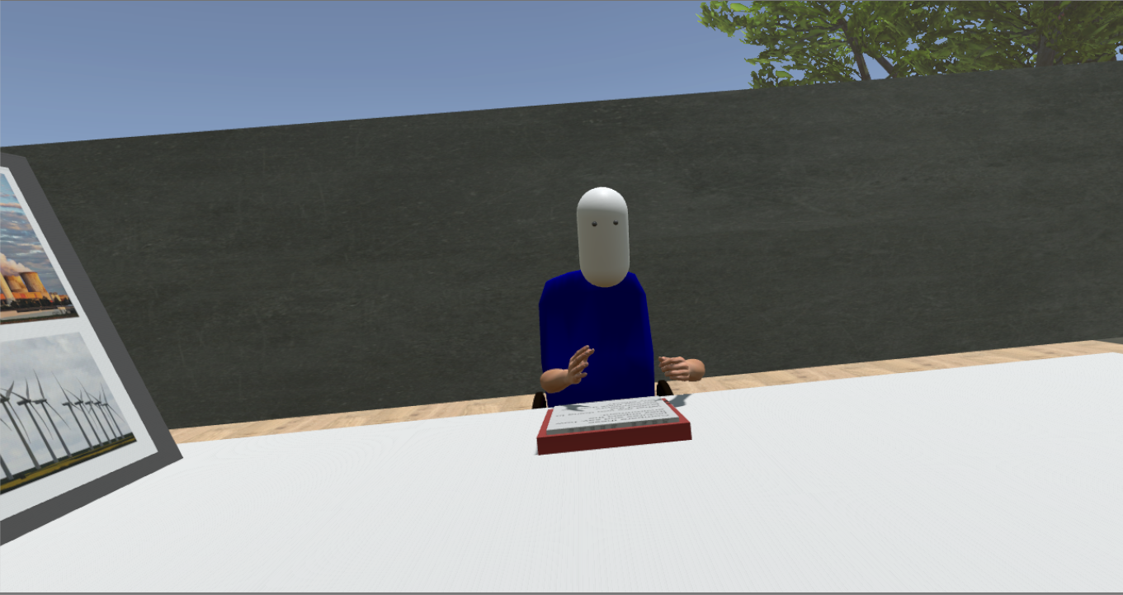

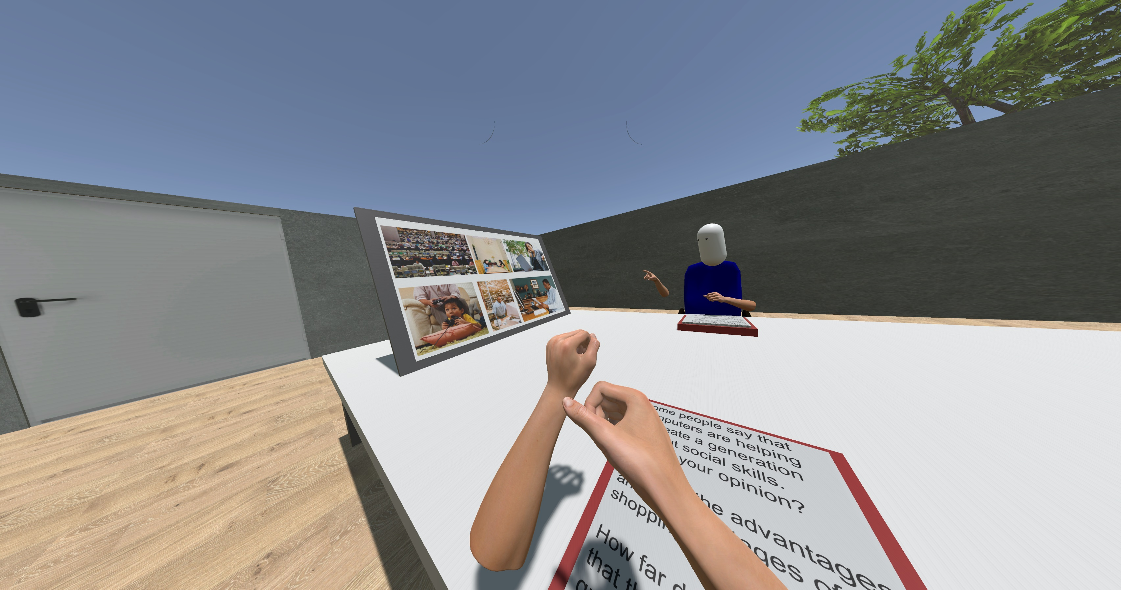
Conditions
fake movement
no movement
real movement
Notes:
Jamie
Own hand movement always „real“

Slide 7
Procedure
Introduction
Repeat for all 3 Conditions
Conclusion
Explanation / Consent Form
6 minute discussion
Semi-structured interview
Setup of the VR HMDs for both participants
Questionnaire
Notes:
klick for every box to appear (introduction, study, conclusion)
Procedure: told them to discuss topics → not tell them study about hand movement
3 sessions → 6 min discussion for each condition
Questionnaires for (co) presence
Interview for qualitative feedback
Position of palms for distance

Slide 8
Results

Slide 9
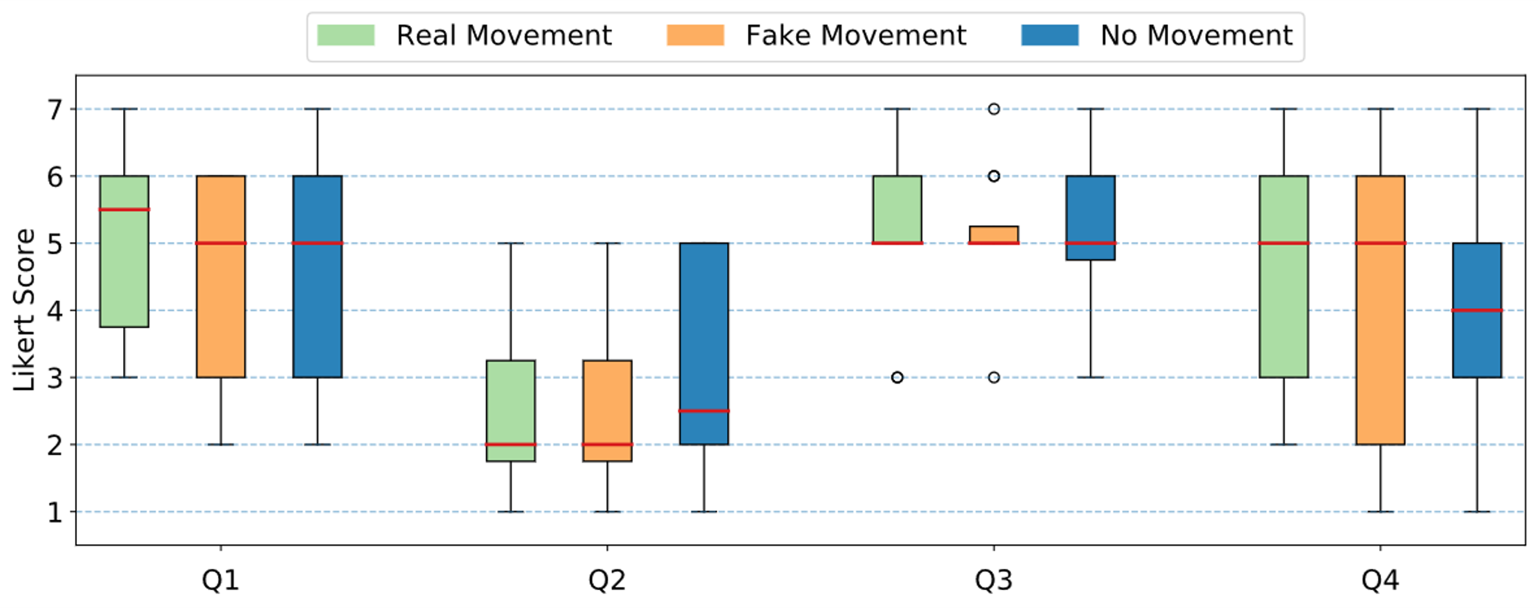
Quantitative: Presence Questionnaire
I was not aware of my real environment
I still paid attention to the real environment
I had the sensation to feel present in the virtual space
It seemed like my own hands were located in the virtual world
Notes:
Jamie
Q1 & I was not aware of my real environment
Q2 & I still paid attention to the real environment
Q3 & I had the sensation to feel present in the virtual space
Q4 & It seemed like my own hands were located in the virtual world
no significant differences

Slide 10
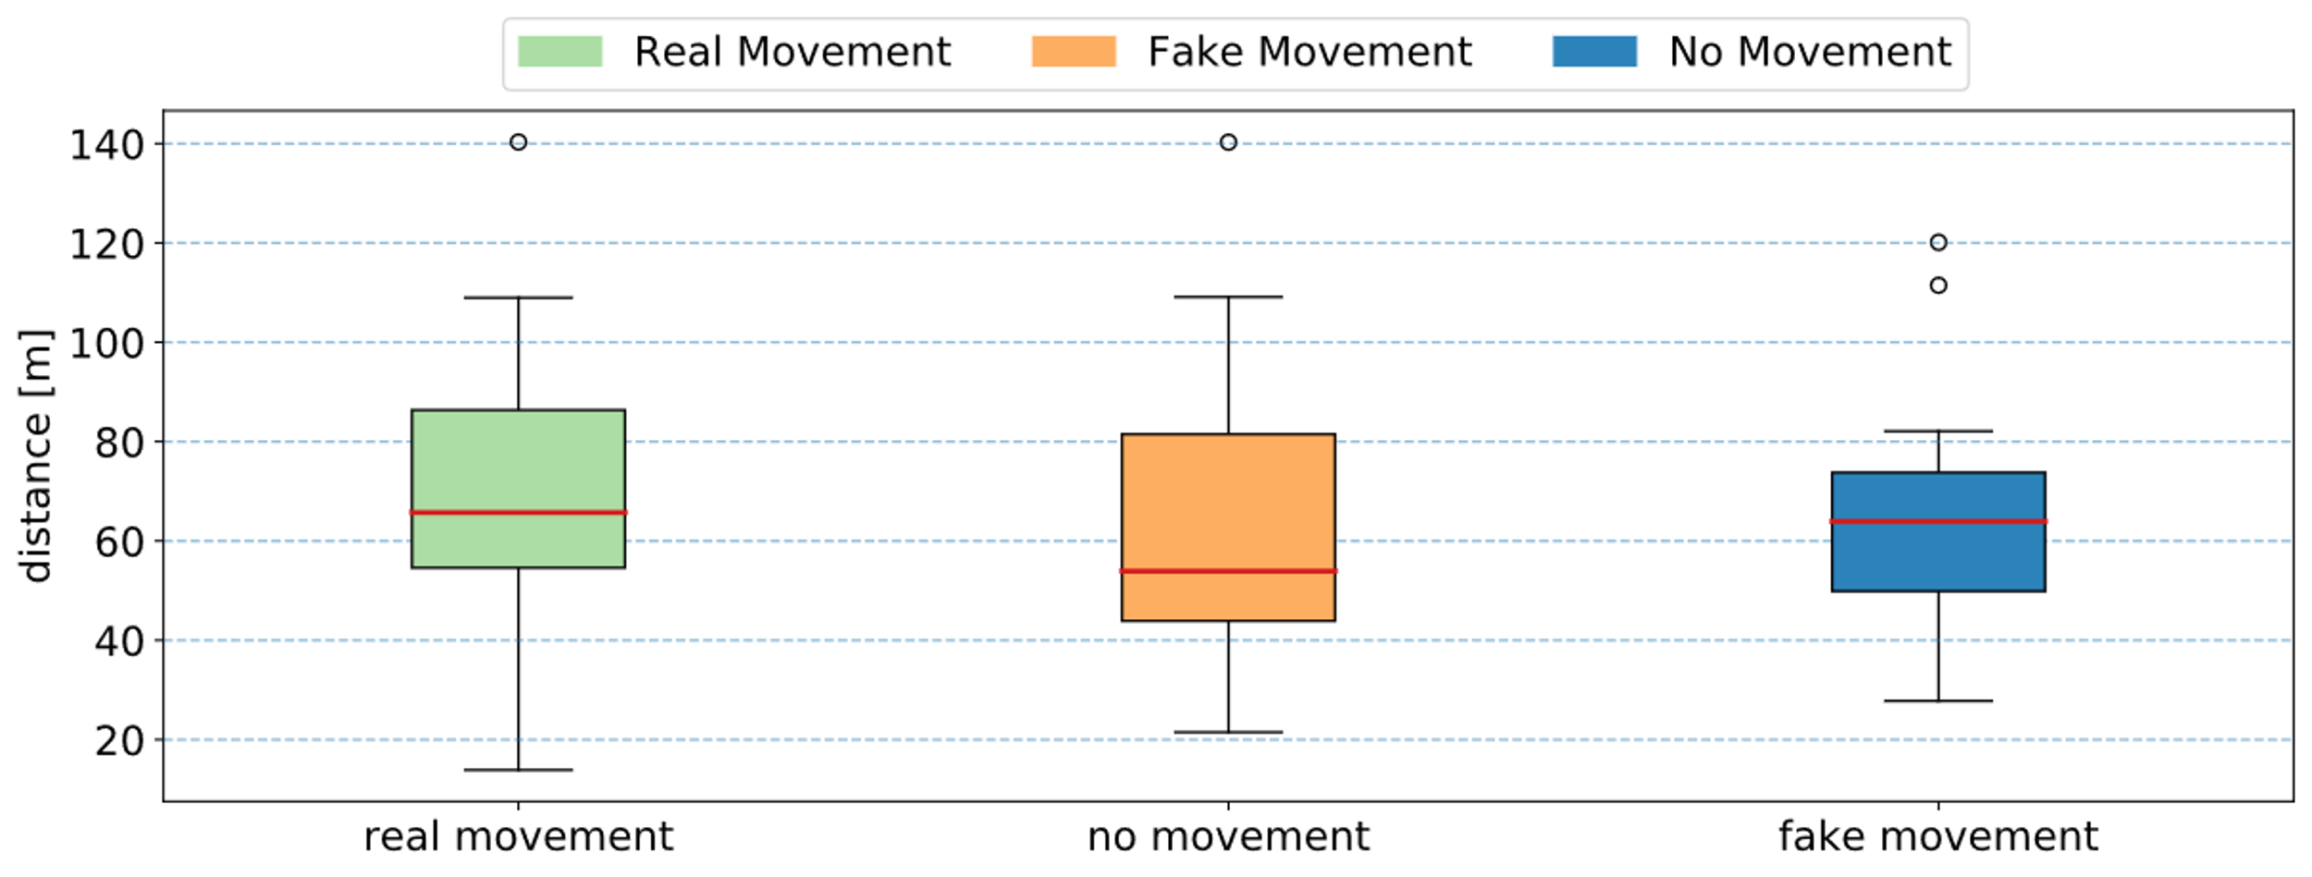
Quantitative: Hand-movement distance
Notes:
Jan
calculation: using Euclidean distance
no significant difference
Confirms the no significant finding from presence

Slide 11
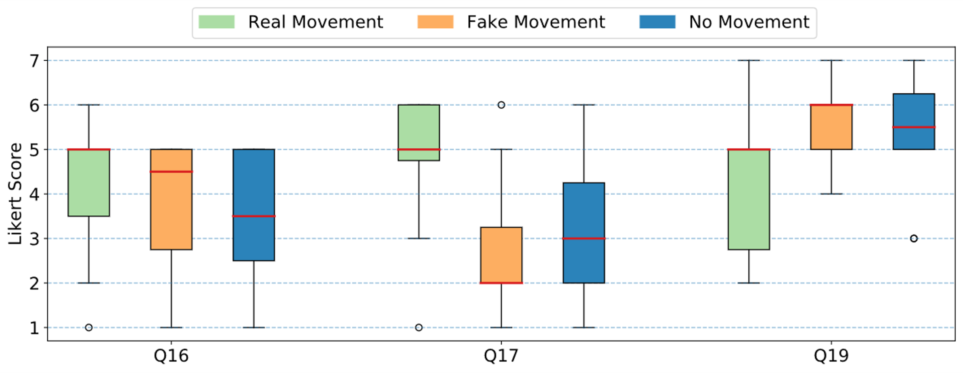
Quantitative: Co-Presence Questionnaire
The person's behaviour had an influence on my mood.
I was able to interpret the person's reactions.
The other person's movement seemed hindered.
Notes:
Felix

Slide 12
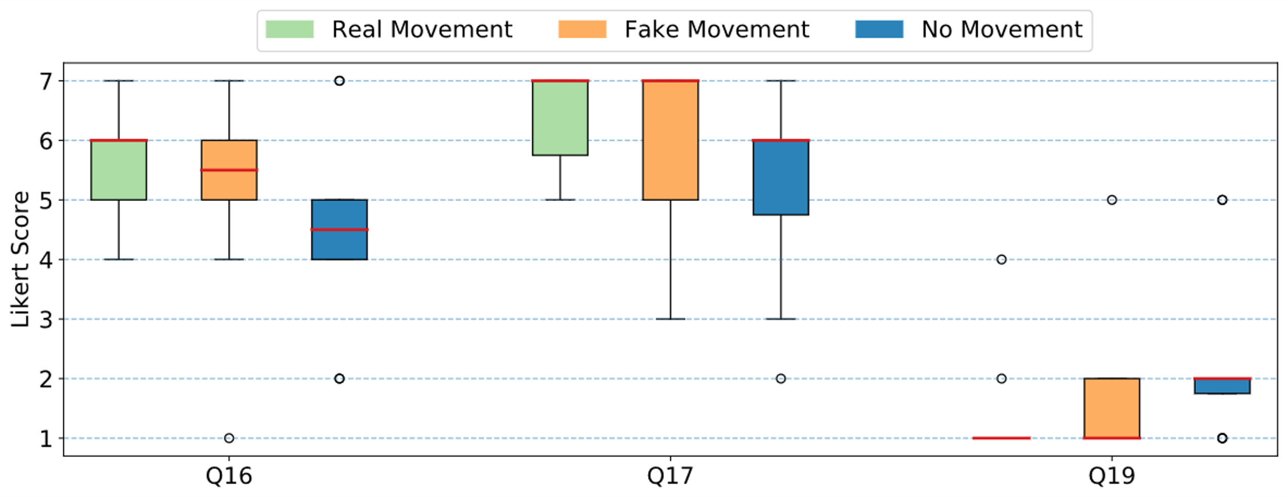
Quantitative: Co-Presence Questionnaire
I had the impression that the person noticed me in the virtual space.
I was aware that other people were with me in the virtual room.
I felt alone in the virtual environment.
Notes:
Felix
significant questions: → klick to ausblenden not significant ones
klicken um jeweils die frage einzublenden → t-test ergebnis sagen und nächste frage
Q6: The person's behaviour had an influence on my mood. → t-test: no x real
Q12: I was able to interpret the person's reactions. → fake x real & no x real
Q16: I had the impression that the person noticed me in the virtual space. → no x real
Q17: I was aware that other people were with me in the virtual room. → no signif. diff.
Q19: I felt alone in the virtual environment. → no x real
Q22: The other person's movement seemed hindered. → fake x real

Slide 13
Qualitative: Interview
Real world
VR / Presence
Study / Co-Presence
Do you think gestures are generally important?
General feeling?
Did you notice the other persons’ movement?
Do you gesture while talking?
Most immersive condition?
Did the other person express themselves through hand-movement?
real > none > fake
Notes:
Jamie
General feeling: most participants liked ability to move hands, but criticised technical implementations (transmission problems, hands disappearing)
which condition most immersive? real movement > no movement > fake movement
gestures important? yes
participant uses many gestures? 50% yes, 50% no/not really
notice other person moving? yes
expressed other person through movement? 33% yes, 33% not at all, 33% strange movements → now and then yes but mostly no

Slide 14
Discussion
Hand movement
important
no influence
influence
influence
Real world
What do I think about the other person?
What does the other person think about me?
Presence
important
necessary
Hand movement in VR is important for expressing oneself
Notes:
Jan

